Slide 1



Malignant Comment Classifier
Presented By: Sahib Hussain
Internship 17

Slide 2
Problem Statement
The proliferation of social media enables people to express their opinions widely online. However, at the same time, this has resulted in the emergence of conflict and hate, making online environments uninviting for users. Although researchers have found that hate is a problem across multiple platforms, there is a lack of models for online hate detection.
Online hate, described as abusive language, aggression, cyberbullying, hatefulness and many others has been identified as a major threat on online social media platforms. Social media platforms are the most prominent grounds for such toxic behaviour.
Internet comments are bastions of hatred and vitriol. While online anonymity has provided a new outlet for aggression and hate speech, machine learning can be used to fight it. The problem we sought to solve was the tagging of internet comments that are aggressive towards other users. This means that insults to third parties such as celebrities will be tagged as unoffensive, but “u are an idiot” is clearly offensive.

Slide 3
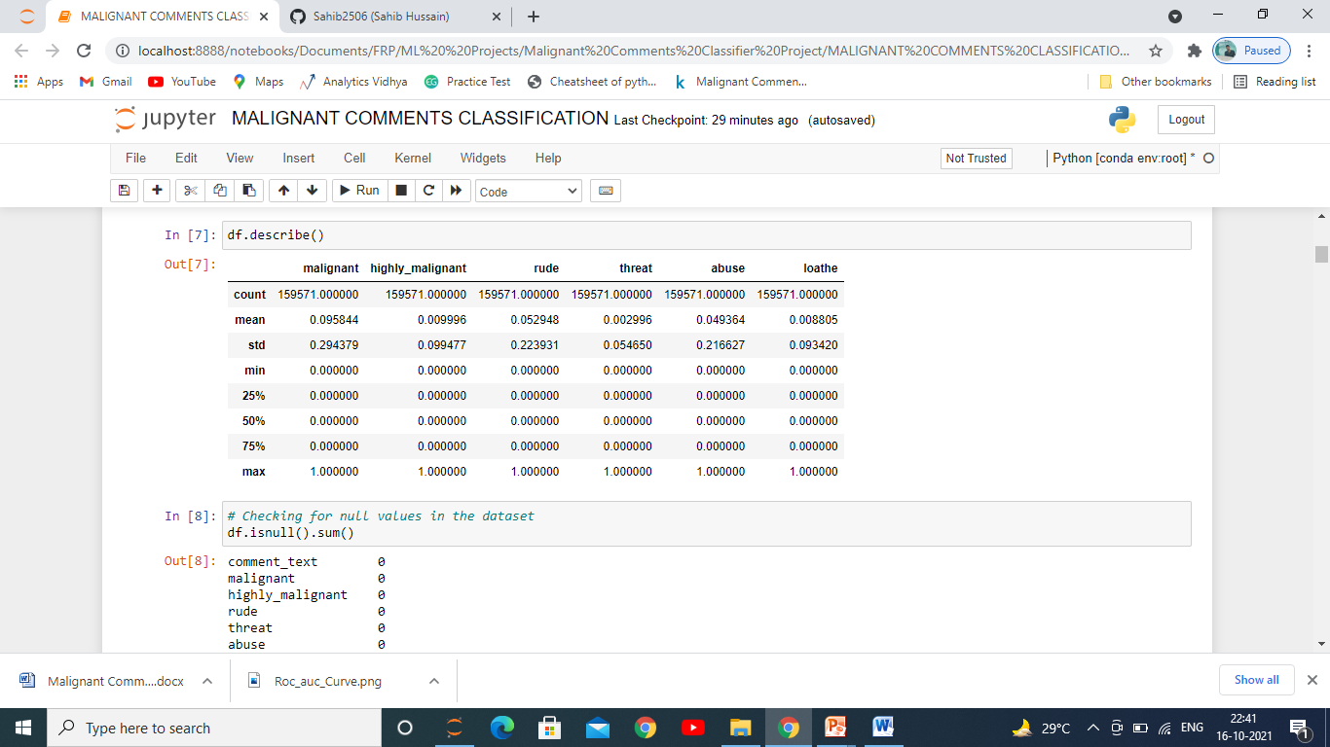
Statistics of Dataset
This dataset had comments from various users which we had to clean and preapare for building the model. From the picture we can see all the output variables ‘ mean, Standard Deviation , the Minimum, 25th,50th,75th quartiles and the Maximum.

Slide 4
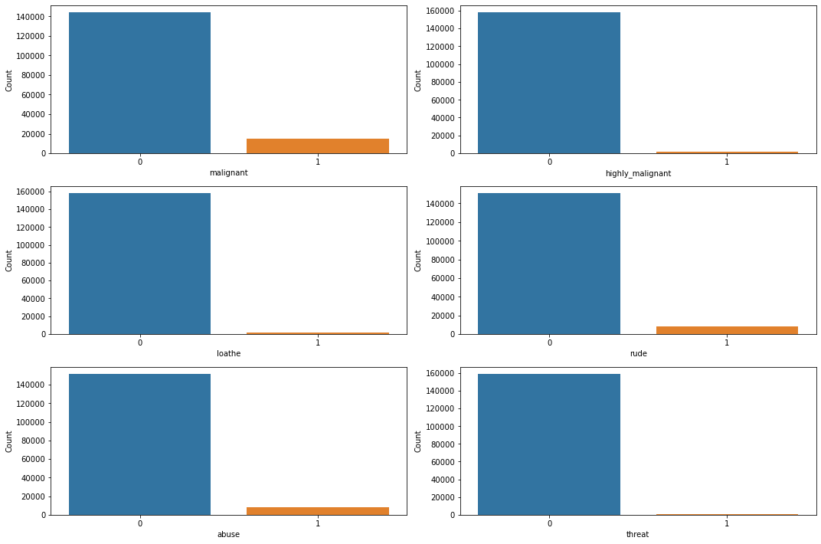
Checking All the Categorical Independent Variables
The above figure shows us the categorical distribution of each of the independent variable and are mostly classified as one for they category type and 0 if it does not fall under that category

Slide 5
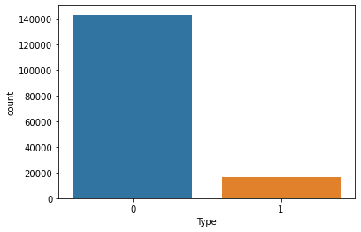
Merging of Dependent Variables
The figure above we see is the resultant Output Variable which we got after Merging all the types of comment categories into a single one for better model building. As from this figure it is clear that there is too much of imbalance.

Slide 6
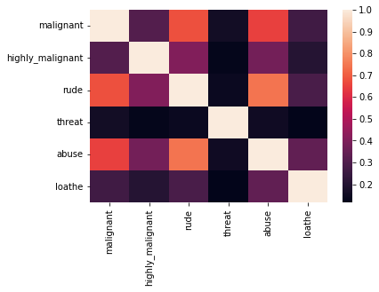
Let’s now see the co-linearity among the Dependent Variables
From the above figure we can see the co-linearity among the dependent variables and as we can see there is no such co-relation among any of these features.

Slide 7
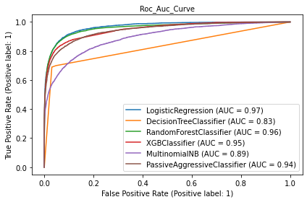
Model Selection
This figure is showing us which of the algorithm performed on this train dataset is covering most of the Area which is Area under the Curve and Logistic Regression as we can see from it was covering the most area for this given trained dataset.

Slide 8
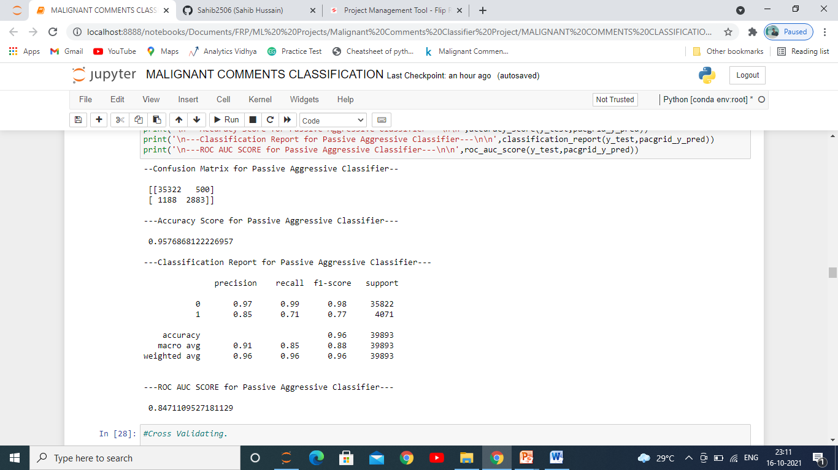
Passive Aggressive Classifier Results
After doing the evaluation of all the algorithms with each and every metrics for classification problem, we saw that the Passive Aggressive Classifier Algorithm was giving us the best results. Above are the results of each and every metric and we can see it is giving us the accuracy of 95.76% and also the Type I and Type II is less when compared with other models.

Slide 9
Conclusion
In this project we found various types of comments which are given by users on social media platform, which category they fall in and how it can be harmful for others if they see such comments, this can also have various impact like political , social and etc. To avoid such things it is important to analyze and prevent such comments before it makes negative impact.

